Slide 1
What does it mean to “market” yourself to an employer?
The hard skills on your RESUME may get you the interview, but your ability to COMMUNICATE will keep you employed. It is your Competitive Edge.

Slide 2
This seminar will:
Define soft and hard Skills and show the difference between the two.
Define Professionalism and what is acceptable in the workplace.
Identify Verbal and nonverbal communication techniques.
Define the stages of the interviewing process and the star method
Discuss job fairs and what they involve
Identify Social Media as a Preparation Tool

Slide 3
In 2018, the National Association of Colleges and Employers reported:
that almost 83% of responding employers said they look for evidence of leadership skills on a candidate’s resume, and nearly as many seek out indications that the candidate can work in a team. Employers also cited written communication skills, problem-solving skills, verbal communication skills, and a strong work ethic as important candidate attributes.

Slide 4
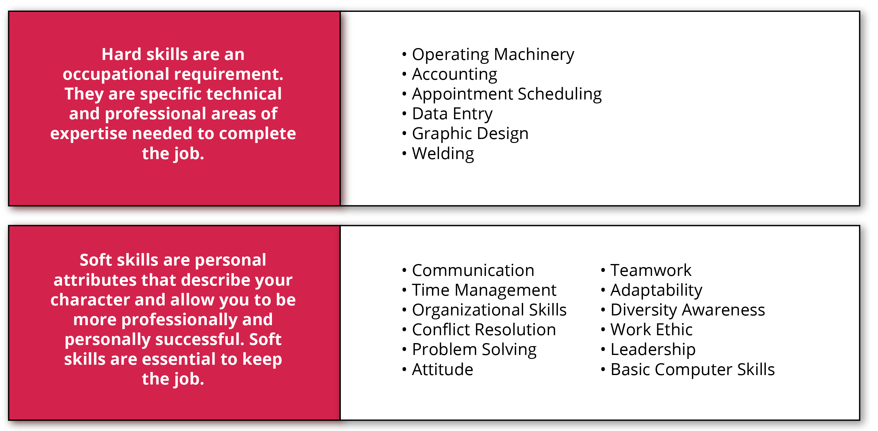
Hard Skills vs. Soft Skills
75% of long-term job success depends on people skills, while only 25% on technical knowledge - Stanford Research Institute, in conjunction with Fortune 500 CEO’s.

Slide 5
The Four Themes Interviewers are Looking for from YOU:
The interview process is designed to determine not only your personality but your fit within the company structure. The four key questions employers are looking for answers to are:
How do I know that you will fit in at my company?
Can I trust/depend on you to do your job well?
How can you improve processes, systems or departments?
How can you save the company time, be efficient, and save/make us money?

Slide 6
Professionalism: Professionalism is not a label you give yourself- It’s a description you HOPE others will apply to you.
David Maister (True Professionalism)
Do YOU have the professionalism needed to land and keep the job?

Slide 7
Verbal vs. Non Verbal Communication
It is reported that 55% of our message comes from body language, 37% from our tone of voice, and only 7% from the words we use. Examples of non-verbal communication:
Tone of voice
Rate and volume of speech
Articulation of words
Rhythm, intonation and stress placed on words
Facial expression
The amount of eye contact made
Gestures/touch
Body language and posturing

Slide 8
Transferable Skills
Transferable skills are skills that are relevant and helpful across different areas of life: socially, professionally and academically.

Slide 9
The STAR Method:
S (Situation): Describe the situation or event that you were involved in.
T (Task): Describe the task or problem you were trying to address.
A (Action): WHAT did you do to solve the task or problem.
R (Result): Explain the results. Keep it POSITIVE. What did you learn and how did it benefit the company, your co-workers, customers, etc.?

Slide 10
Create Your Own Pitch
STEP 1: Introduce yourself, and then explain what you do in five or six words.
"I am trained in the field of...." or " I am an expert in...."
STEP 2: Provide a few brief examples of your career accomplishments.
"I successfully helped my company...", "Last year, I closed 'X' amount of business deals" and "I developed a new system that....”
STEP 3: Explain your work philosophy
"I believe in professionalism, delivering a quality work product and approaching everything with an open mind."
STEP 4: Be specific when you explain what you are looking for in your job search
"I am looking for a company that offers..." or "that focuses on a specific area."

Slide 11
Illegal Questions
Race
Height and Weight
Financial Information
Religious Beliefs or Affiliation
Citizenship
Marital Status or Number of Children
Disability and Medical Conditions

Slide 12
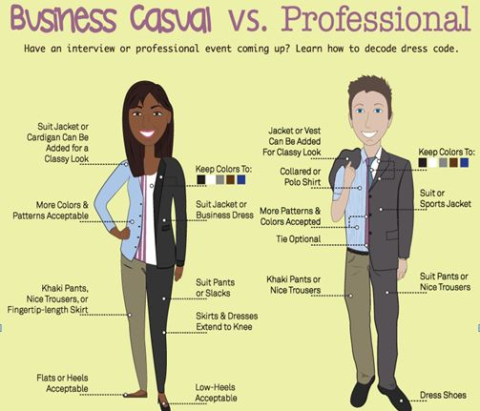
What to Wear?

Slide 13
Social Media as a Resource

